Slide 1
Cyclistics Riders Analysis

Slide 2
How do annual members & casual riders use Cyclistic bikes differently?

Slide 3
Data Set
Divvy Trip Data: https://divvy-tripdata.s3.amazonaws.com/index.html
Divvy_Trips_2019_Q2.csv
Divvy_Trips_2019_Q3.csv
Divvy_Trips_2019_Q4.csv
Divvy_Trips_2020_Q1.csv

Slide 4
Tech Used for Analysis
R
Excel

Slide 5
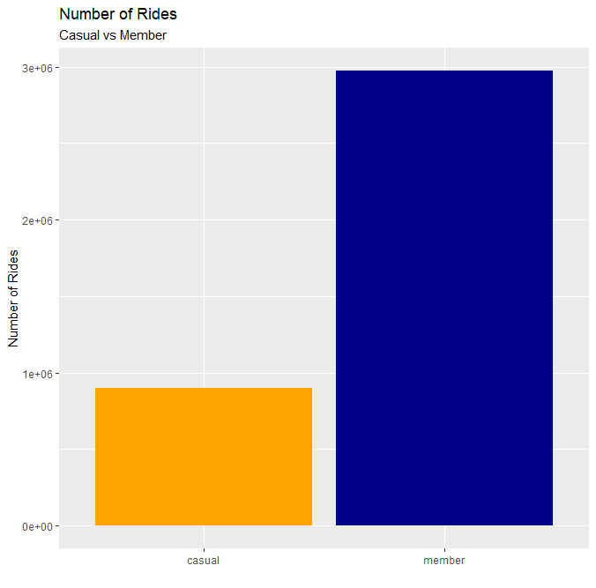
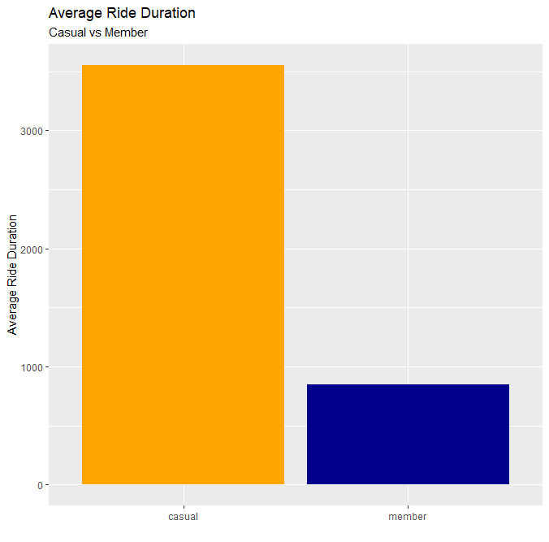
Comparing Average Number of Rides & Average Ride Duration between Casual Riders and Members:

Slide 6
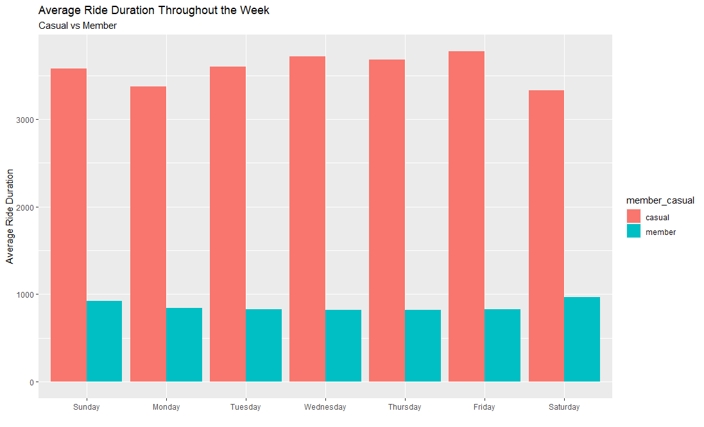
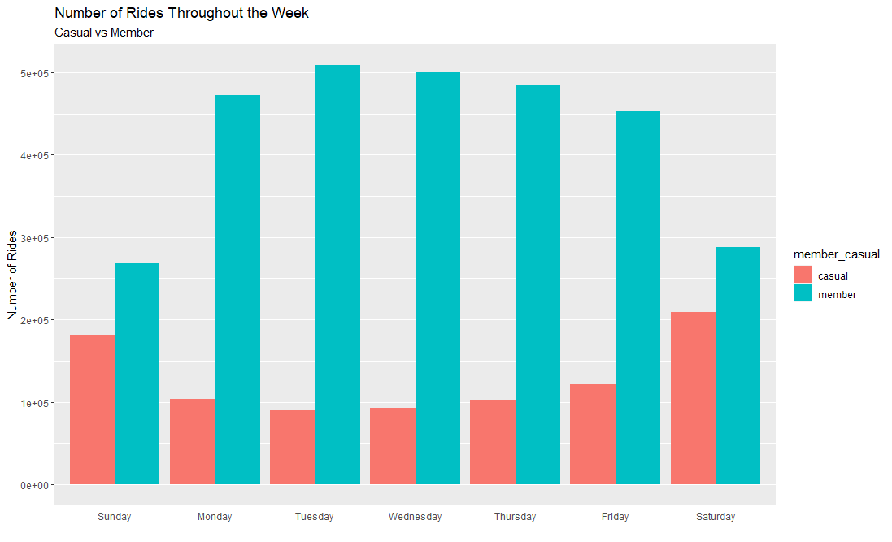
Average Ride Duration & Number of Rides by Type and Weekday:

Slide 7
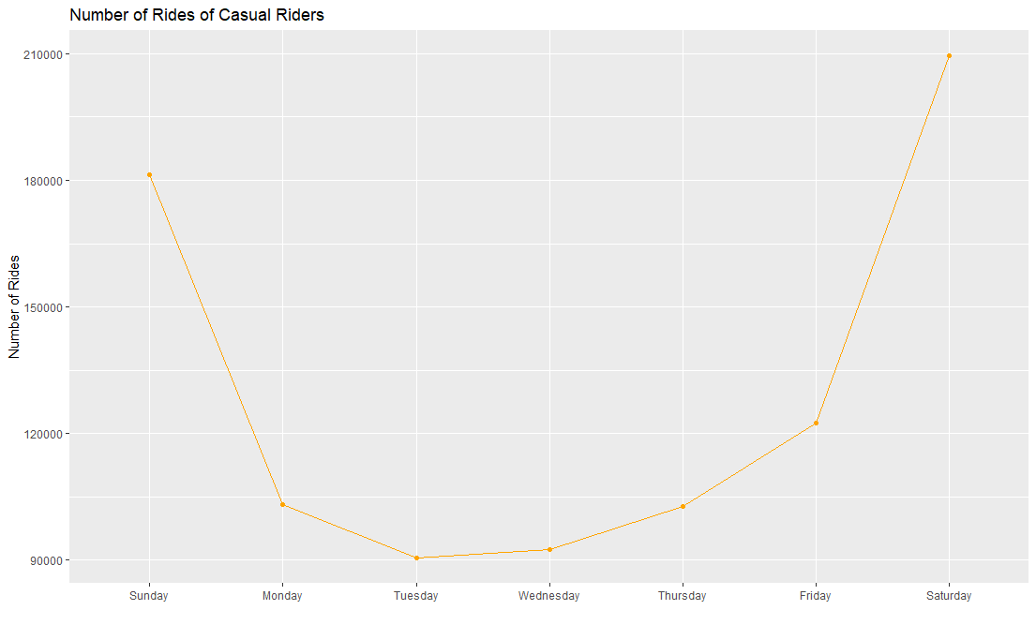
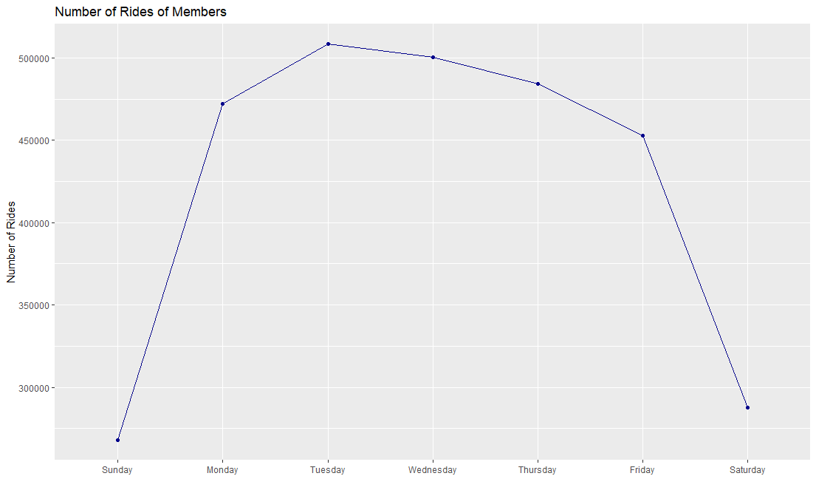
Number of Rides Trend for Casual Riders vs Members:

Slide 8
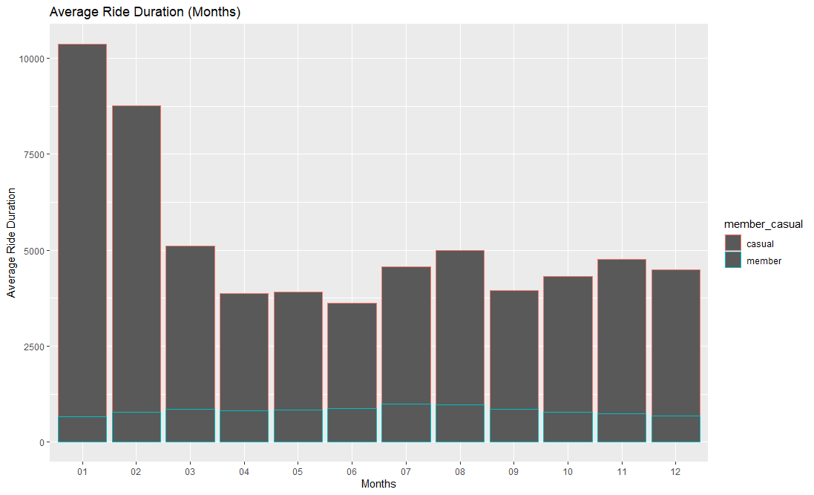
Average Ride Duration by Type and Month:

Slide 9
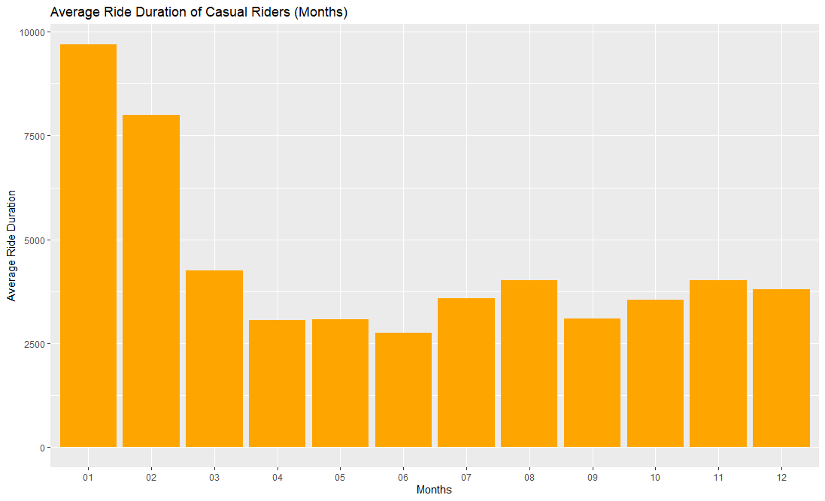
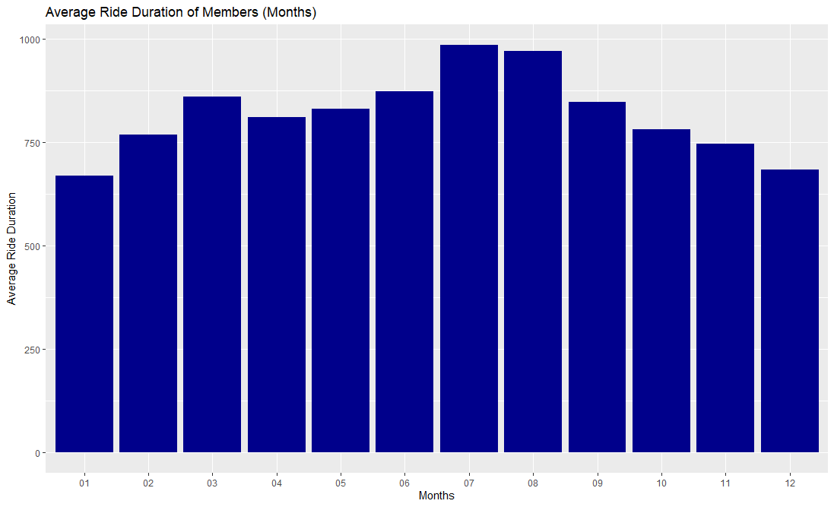
Average Ride Duration by Type and Month:

Slide 10
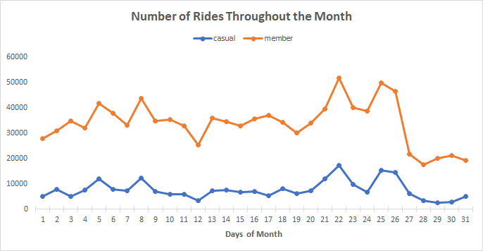
Number of Rides Throughout the Month:

Slide 11
Conclusion: Casual Riders
Reasons for Using Bikes:
Relaxation & Bonding Exercise
Meet New Year’s Resolution
Riding Trends:
Higher average ride duration than members throughout the week
Use more often on weekends
Use significantly longer in the first few months

Slide 12
Conclusion: Annual Members
Reasons for Using Bikes:
Form of Transportation
Riding Trends:
Use more compared to casual riders all together
Use more often on weekdays
Consistent riding duration throughout the year

Slide 13
Recommendations
Advertise during New Year's period to convince casual riders to convert to members.
Encourage casual riders to sign up for membership to use bikes as alternative mode of transportation, for health and environment.
Introduce an exclusive members' community with members' only bonding and relaxation events/activities.

Slide 14
Future Improvements
Collect survey data for analysis to better understand the decision-making mindset of casual riders vs members.
A larger data set can be used for analyzing longer term trends and behaviors of riders.
The start and end stations can be analyzed to see if there are any particular areas that have more members and find the reasons for such occurrences.

Slide 15
Thank You!

